Slide 1
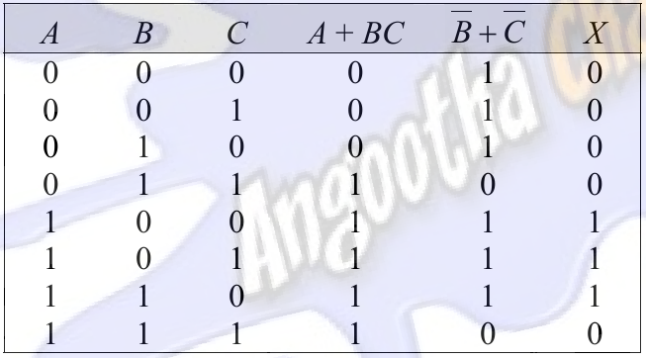
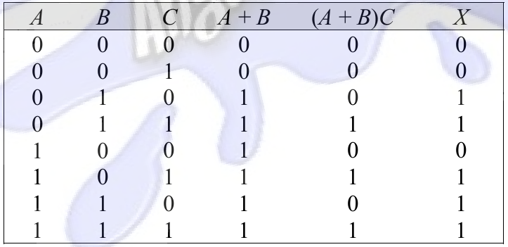
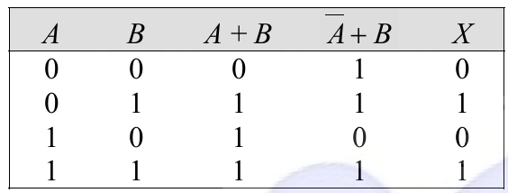
6.Find the value of X for all possible values of the variables.
(a) X=(A+B)C+B (d) X=(A+B)(A’+B)
(e) X=(A+BC)(B’+C’)
(a) X=(A+B)C+B
(e) X=(A+BC)(B’+C’)
(d) X=(A+B)(A’+B)

Slide 2
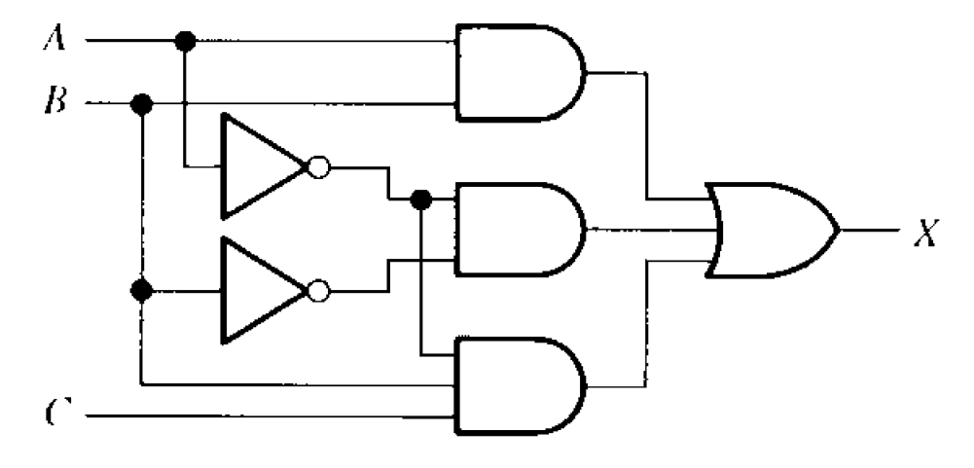
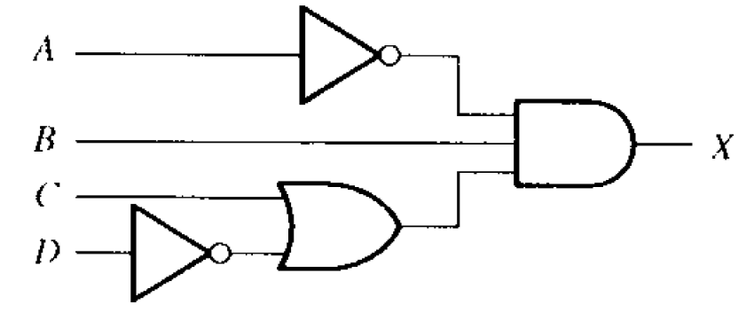
15.Draw the logic circuit represented by each expression:
(b) AB+A’B+A’BC (c) A’B(C+D’)
(b) AB+A’B+A’BC
(c) A’B(C+D’)

Slide 3
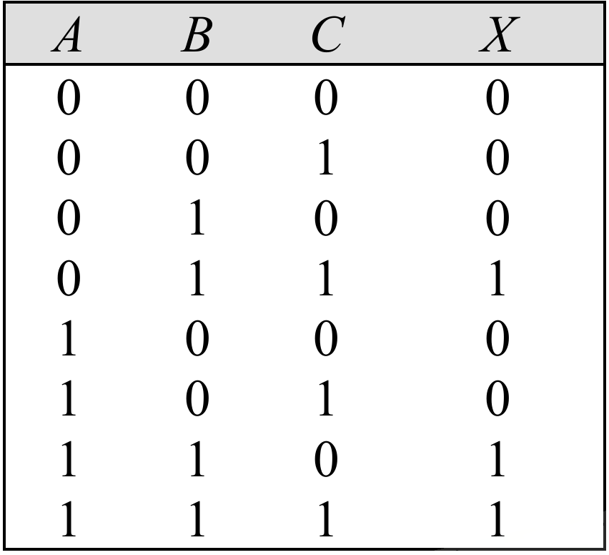
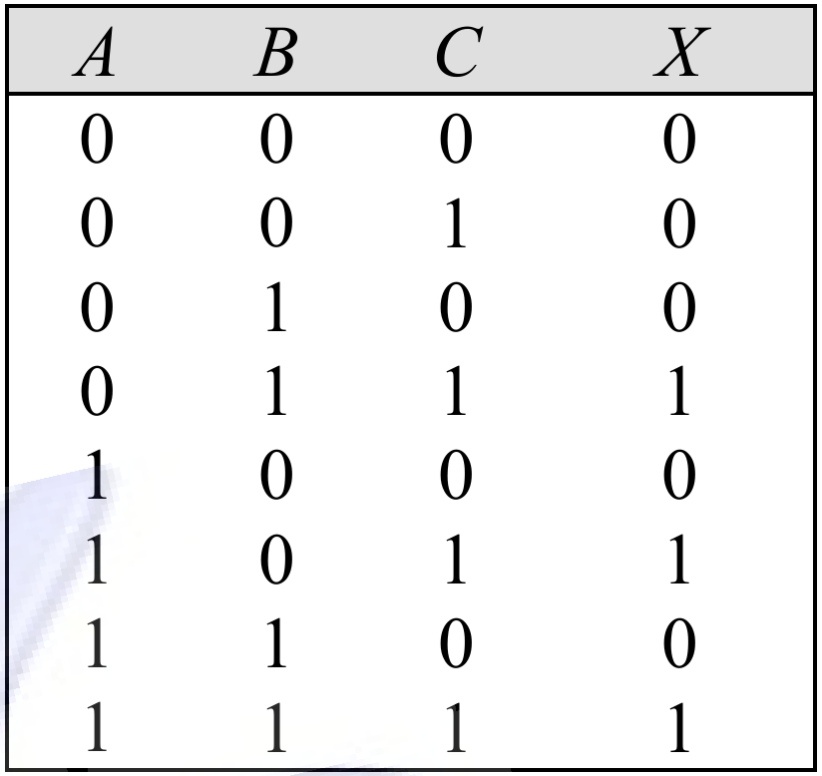
18.Construct a truth table for each of the following Boolean
expressions:
(c) AB+BC (d) (A+B)C
(c) AB+BC
(c) A’B(C+D’)

Slide 4

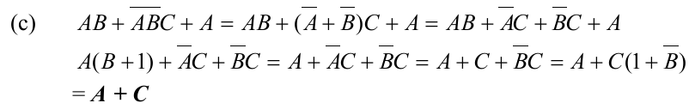

20.Using Boolean algebra, simplify the following expressions:
(b) A’B+A’BC’+A’BCD+A’BC’D’E (c) AB+A’B’C+A
(e) AB+(A’+B’)C+AB

Slide 5
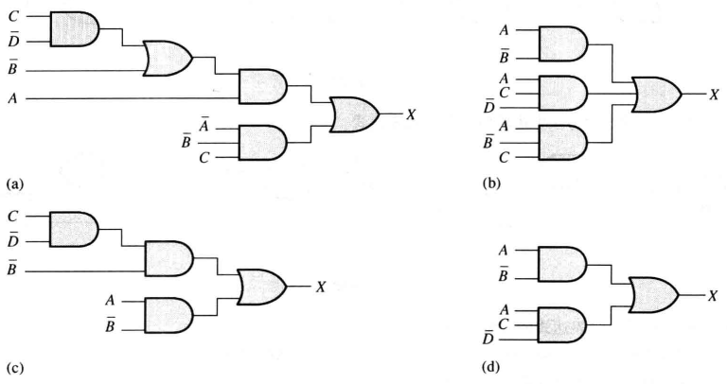
22.Determine which of the logic circuits in Figure 4-56 are
equivalent.

Slide 6
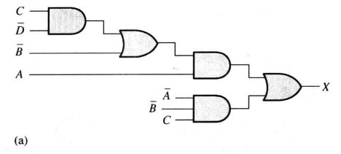
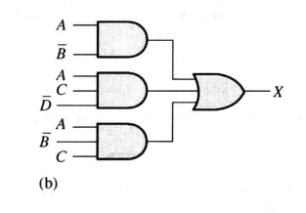
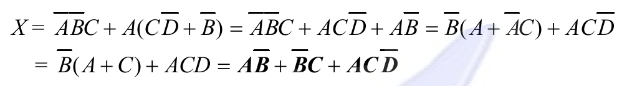
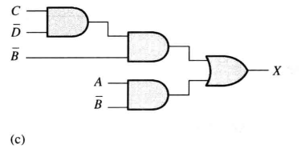
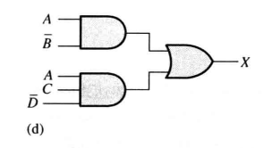


Slide 7
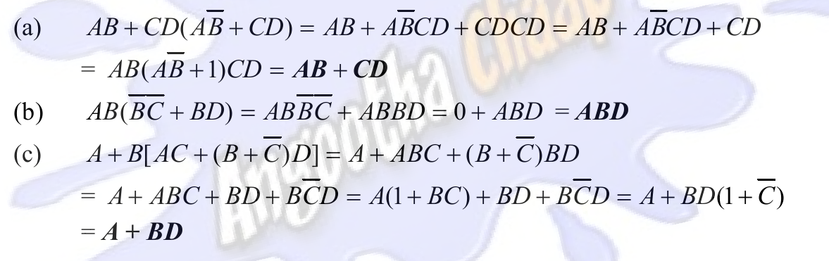
24.Convert the following expression to sum-of-product(SOP)
forms:
(a) AB+CD(AB’+CD) (b) AB(B’C’+BD)
(c) A+B[AC+(B+C’)D]

Slide 8
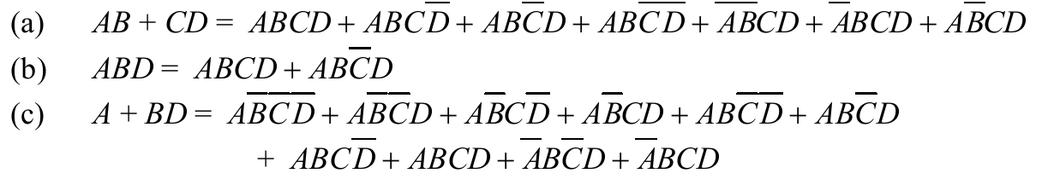
26.Convert each SOP expression in Problem 24 to standard SOP
form.

Slide 9
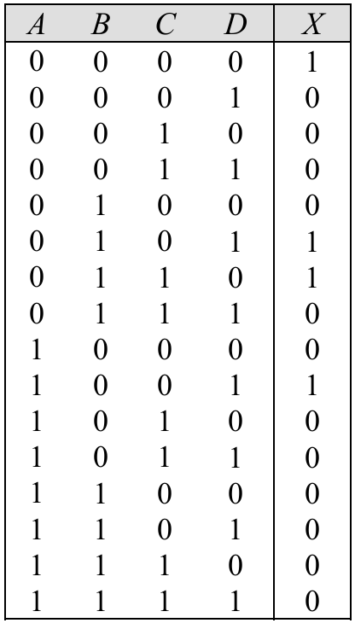
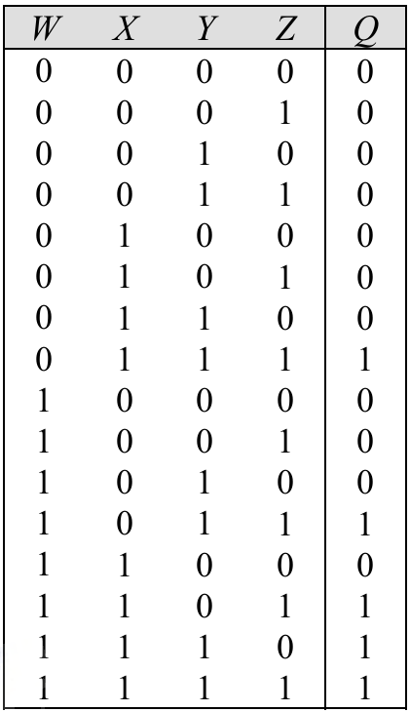
32.Develop a truth table for each of the following standard SOP
expressions:
(a) A’BC’D+A’BCD’+AB’C’D+A’B’C’D’
(d) WXYZ+WXYZ’+W’XYZ+WX’YZ+WXY’Z

Slide 10
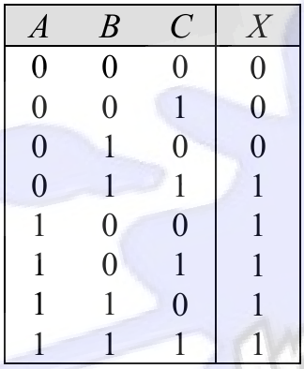
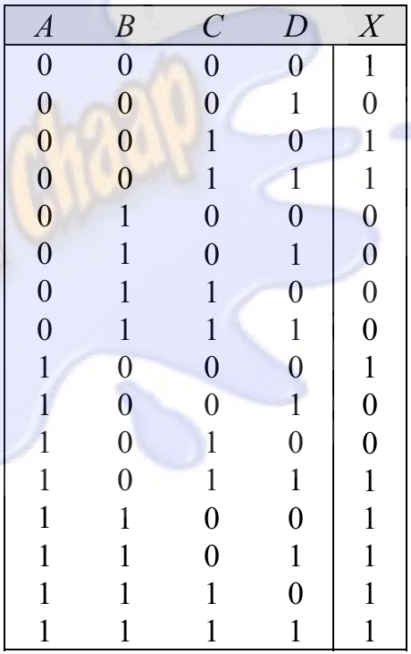
35.Develop a truth table for each of the standard POS expressions:
(a) (A+B)(A+C)(A+B+C)
(b) (A+B’)(A+B’+C’)(B+C+D’)(A’+B+C’+D)

Slide 11
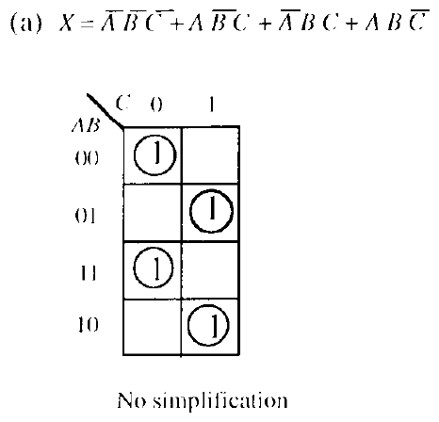
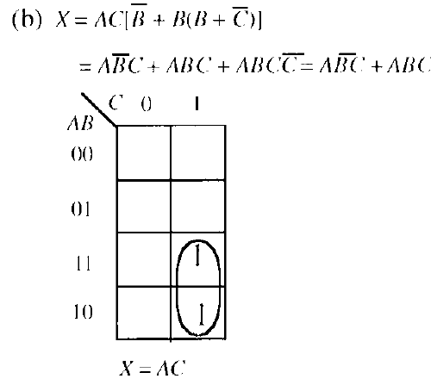
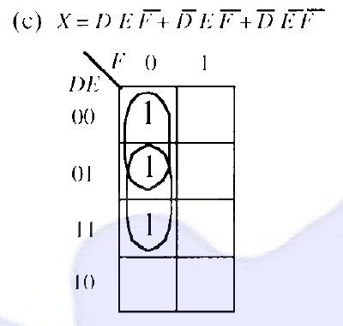
41.Use a Karnaugh map to simplify each expression to a minimum
SOP form:
A’B’C’+AB’C+A’BC+ABC’ (b) AC[B’+B(B+C’)]
(c) DEF’+D’EF’+D’E’F’

Slide 12
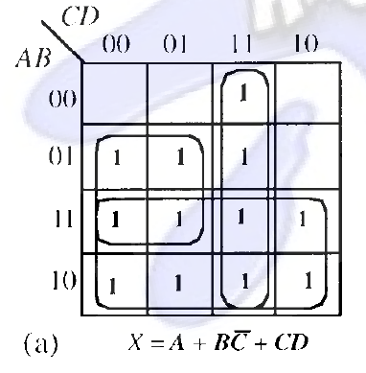
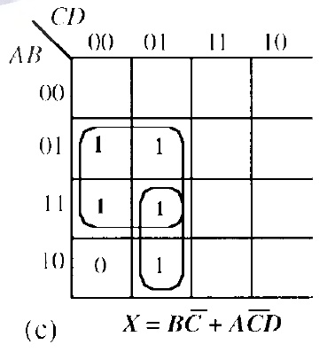
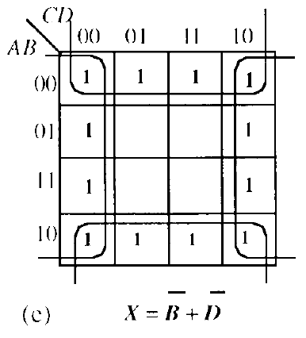
44.Use a Karnaugh map to reduce each expression to a minimum SOP form:
A+BC’+CD
(c) A’B(C’D’+C’D)+AB(C’D’+C’D)+AB’C’D
(e) (AB)’+AB’+C’D’+CD’

Slide 13
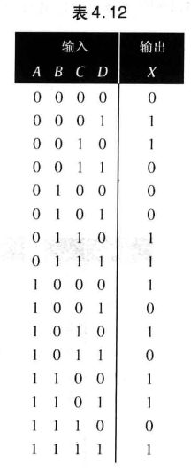
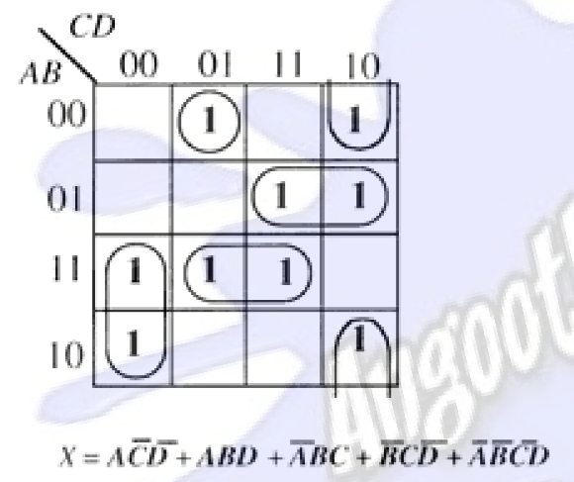
46.Use a Karnaugh map to implement the minimum SOP form
for the logic function specified in truth table 4-12.

Slide 14
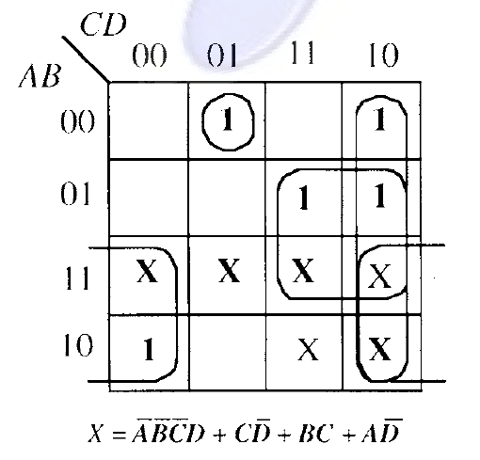
47.Solve Problem 46 for a situation in which the last six binary
combinations are not allowed.

